Slide 1

HAB (Harmful Algal Bloom) Detection System
Team : Gradient Descents
Week 2 Updates
Objectives :
Analyze and visualize environmental data related to cyanobacterial blooms
Identify high-risk periods and regions using patterns from historical data
Train machine learning models to predict severity levels of HAB
Build an interactive frontend dashboard for users to explore and query the system

Slide 2
Current System Architecture
Backend
Cleaned and structured dataset from multiple sources
Added engineered features (season, time, date)
Severity levels classified into 5-point scale
Modeling
Tree-based classifiers (Random Forest, XGBoost) evaluated
Chosen model will be integrated into the prediction API
Frontend
Streamlit dashboard for visualization and user input
Displays maps, seasonal trends, severity distribution

Slide 3
Progress Since Last Presentation
Completed full EDA on cleaned dataset (abundance, severity, seasonal trends)
Plotted spatial and seasonal severity patterns
Added engineered features like log_abun, abundance_class, season, and is_near_water
Evaluated multiple ML models, selected best-performing one
Developed initial frontend dashboard with interactive visualizations

Slide 4
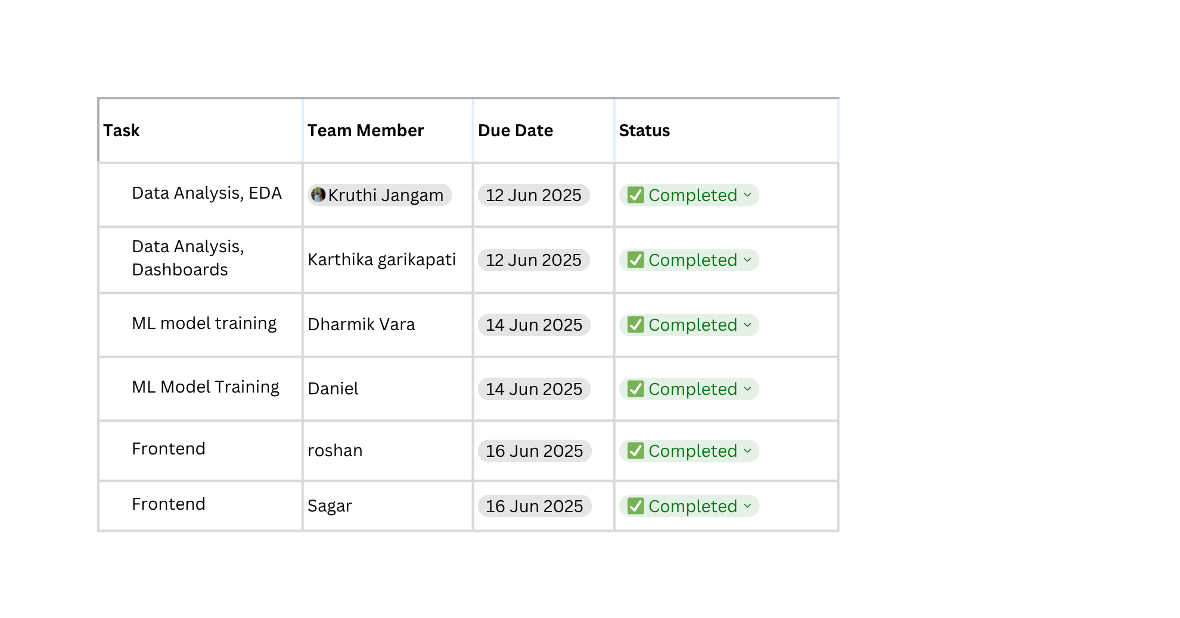
Members Task Update

Slide 5
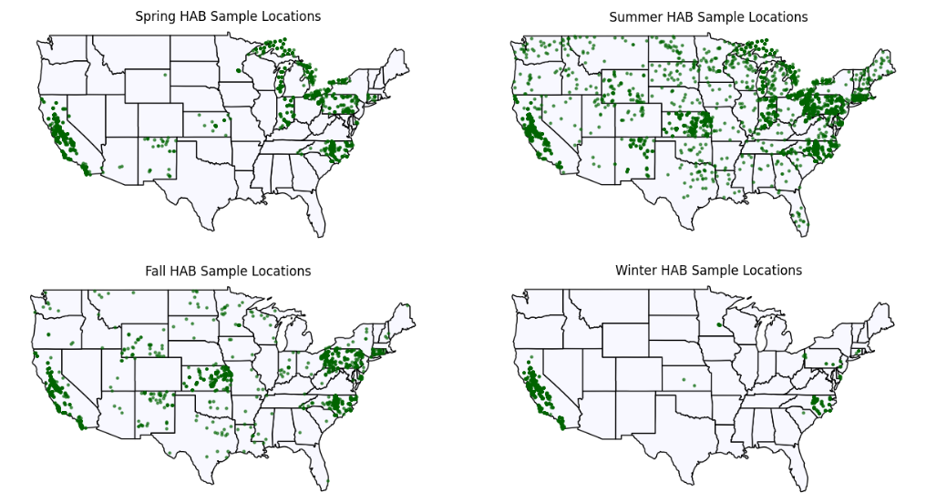
Data Analysis

Slide 6
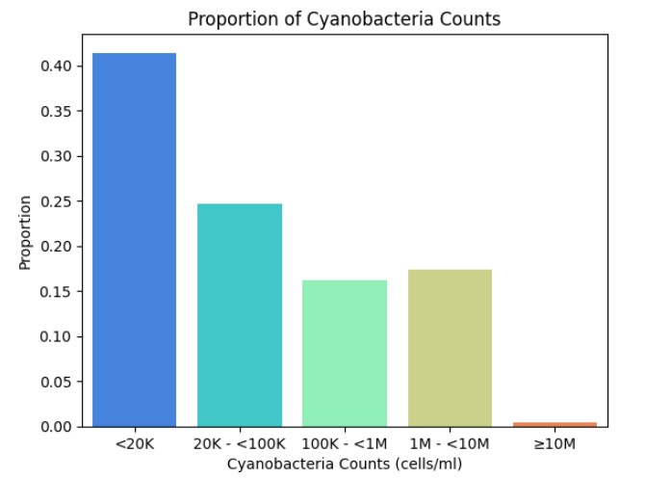
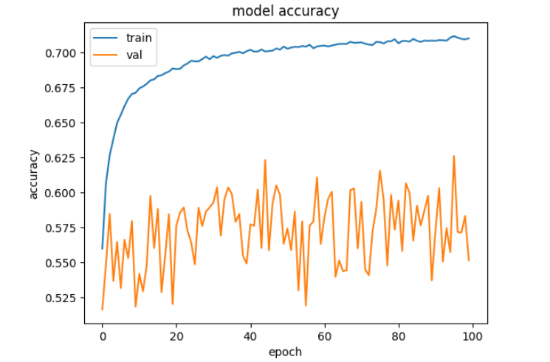
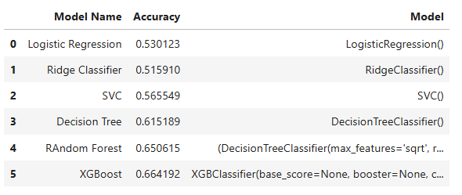
Model Training

Slide 7
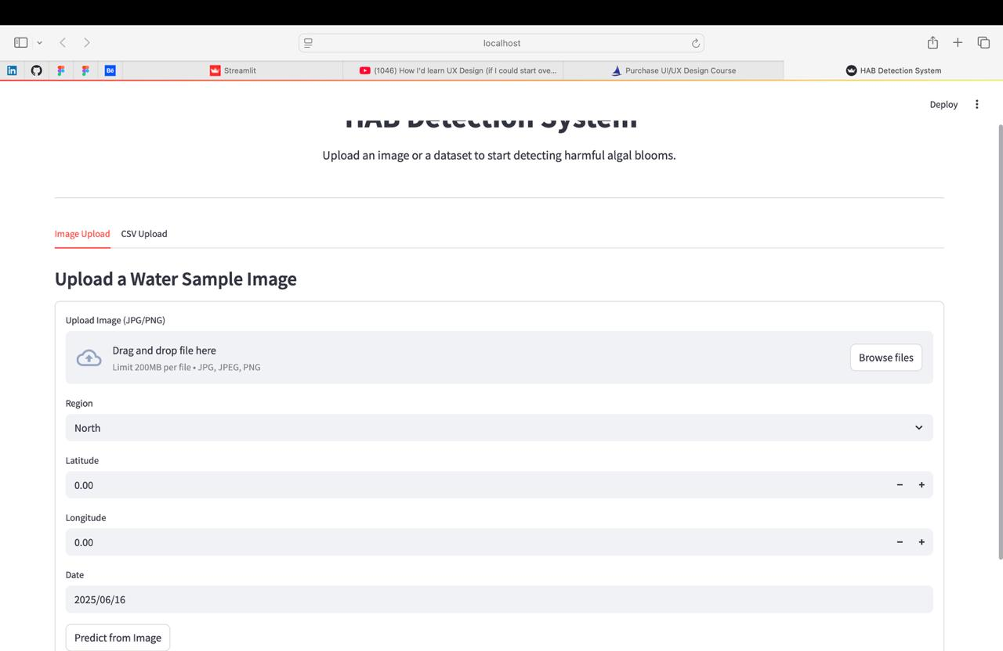
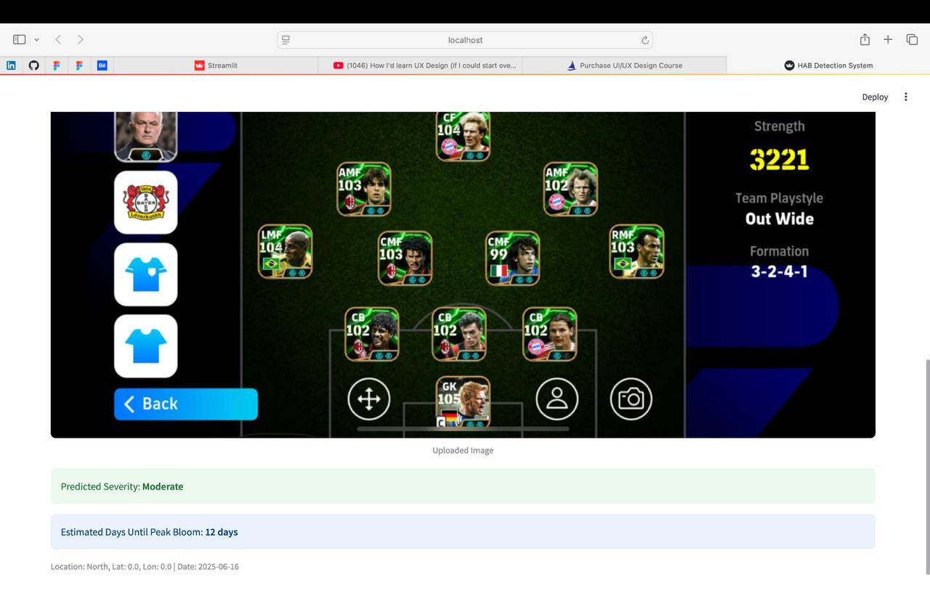
Front End

Slide 8
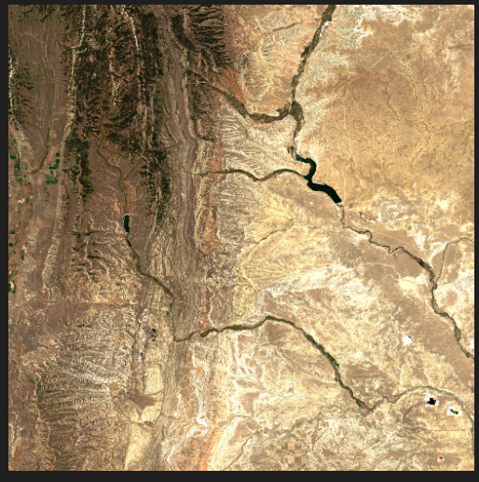
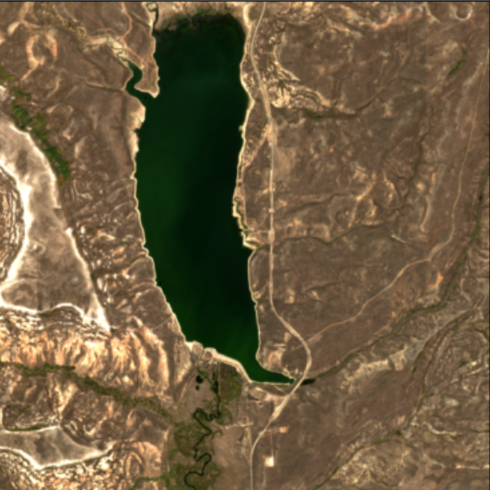

Slide 9

Plans for the Coming Week
Integrate final ML model into backend
Add inference pipeline to allow predictions from user-uploaded data
Add map-based filters to dashboard for better usability
Package the system and document the GitHub repo properly
Prepare a final demo video and walkthrough

Slide 10
Reference
S. Gupta, E. Gelbart, R. Gupta, K. Wetstone, and E. Dorne (2024). Cyanobacteria Aggregated Manual Labels Dataset (NASA and DrivenData). SeaBASS. http://dx.doi.org/10.5067/SeaBASS/CAML/DATA001

